Slide 1
SOLILOQUY
SOLILOQUY
Home
Requirements
Features
Technical
challenges
Future
Live your life

Slide 2
ABOUT US
SOLILOQUY
Home
Requirements
Features
Technical
challenges
Future
22pmc139
Nandhu Jayan

Slide 3
01. 1. Overview
SOLILOQUY
Home
Requirements
Features
Technical
challenges
Future
CONTENTS
01. 2. PROJECT REQUIREMENTS
01. 3. FEATURES AND HIGHLIGHTS
4.SCREENSHOTS
01. 5.THIRD PARTY LIBRARIES
01. 6.ARCHITECTURE OF THE PROJECT
01. 7.CLASS DIAGRAM
01. 8.CHALLENGES
01. 9.FUTURE ENHANCEMENT
10.CONCLUSION
11.REFERENCE

Slide 4
Overview
SOLILOQUY
Home
Requirements
Features
Technical
challenges
Future
Soliloquy is a social media platform dedicated to supporting individuals facing sadness and depression.
It offers a safe and empathetic space where users can express themselves, connect with others who understand their experiences, and access valuable mental health resources. Soliloquy's features include post sharing, interactive engagement, private messaging, and a chat-bot feature.
It aims to provide a nurturing online community that promotes emotional well-being and offers a sense of belonging to its users.

Slide 5
Project requirements
SOLILOQUY
Home
Requirements
Features
Technical
challenges
Future
1. User can Register and login
2. User can view the home page
3. User can view the post
4. User can add post
5. User can like and comment on the post.
6. User can save others post.
7. User can sent friend reuqest.
8. User can follow others.
9. User can approve friend request
10. User can sent messages to friends.
11. User can watch who all are the friends of the other user.
12. User can recieve messages
13. User can logout
14. Users can view the liked post.
15. AI chatbot

Slide 6
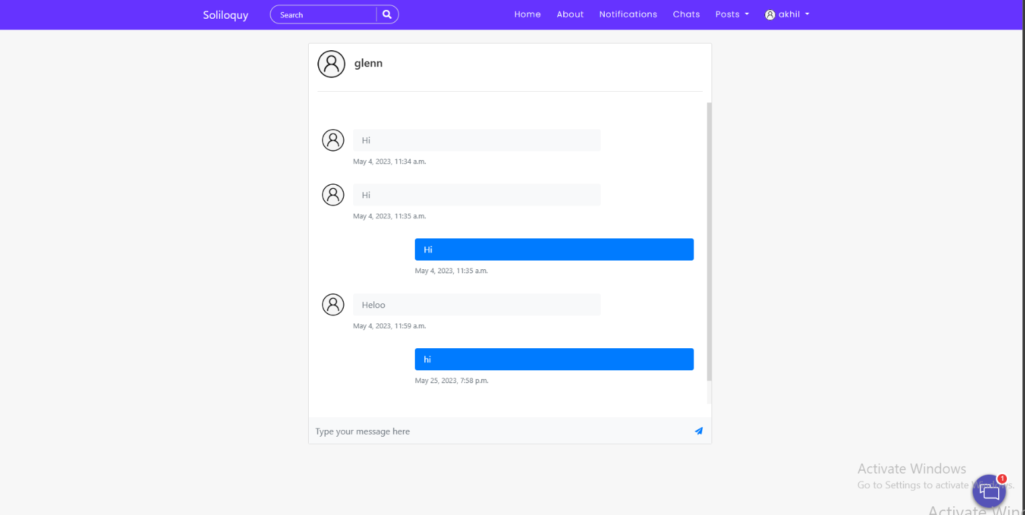
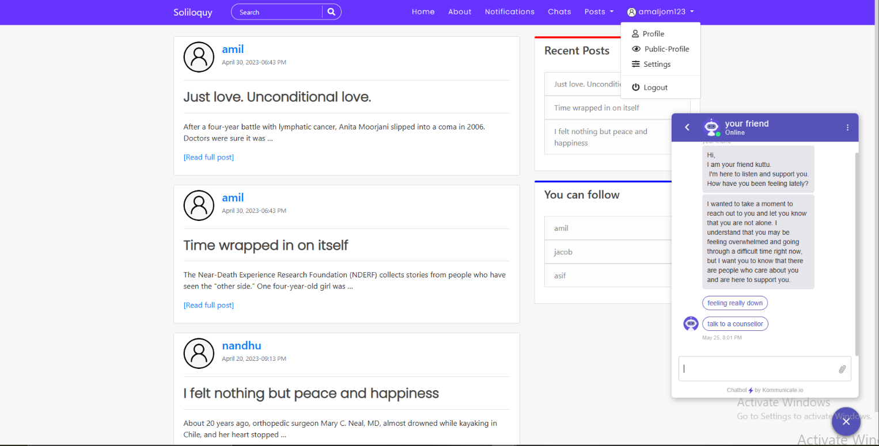
Messaging System
AI-Chat bot
SOLILOQUY
Home
Requirements
Features
Technical
challenges
Future
Features and highlights
Users can send private messages to their friends.
Implement a real-time messaging system to facilitate private conversations.
Soliloquy incorporates an AI-powered chatbot to provide automated assistance and support to users.
Kommunicate.io is a customer support and chatbot platform which is used to implement AI-chat bot feature in soliloquy

Slide 7
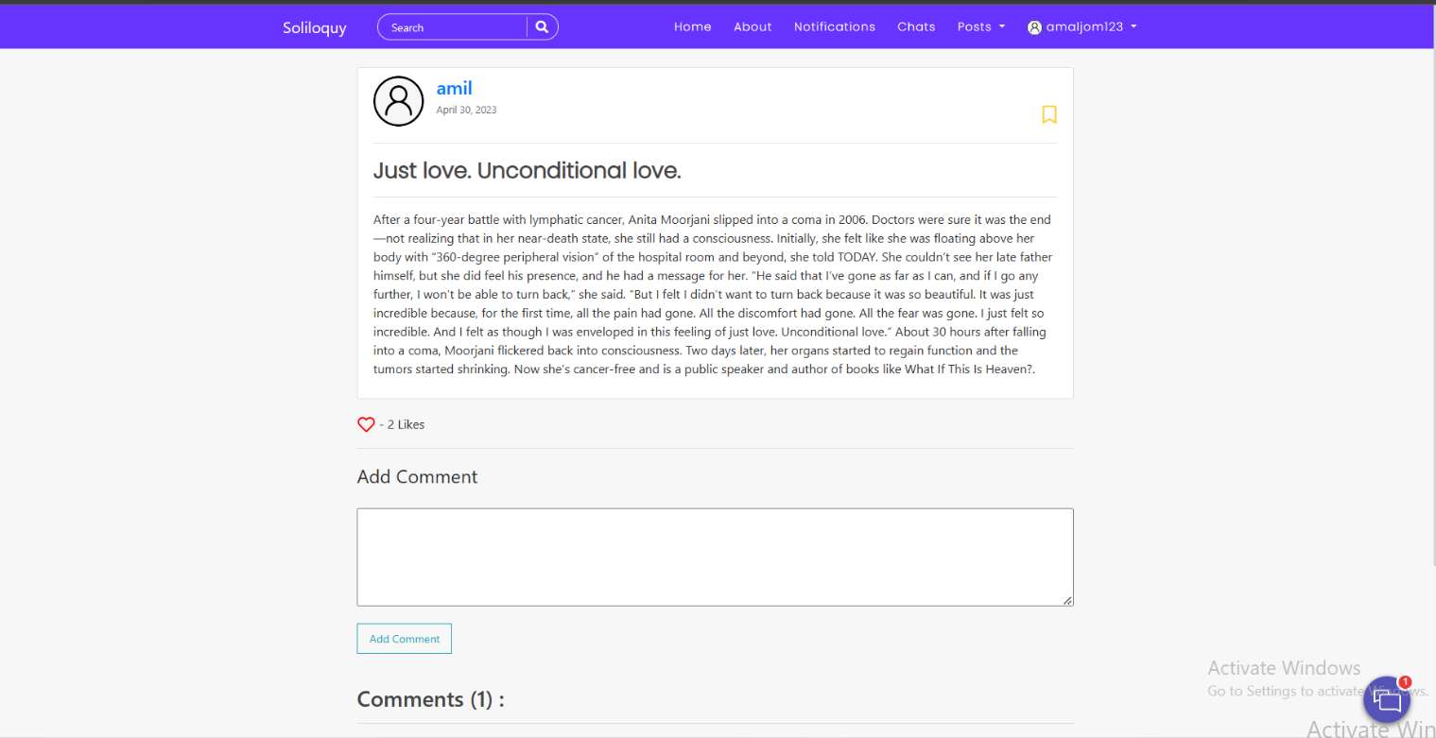
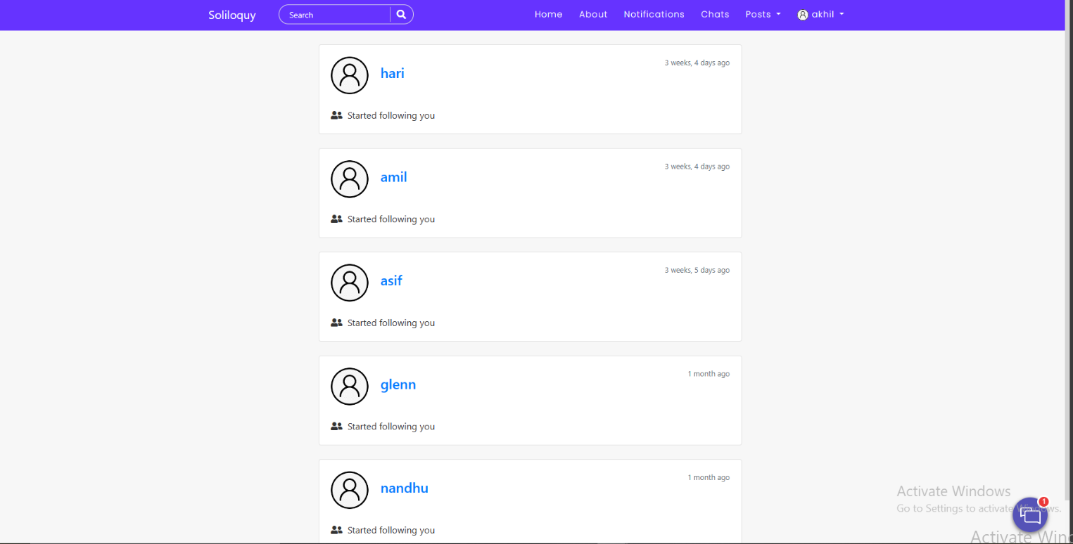
View post
Notifications
SOLILOQUY
Home
Requirements
Features
Technical
challenges
Future
Users can view the post uploaded by other users
Users can like and comment on the post
We will receive notifications if other users start following us or if we receive comments or likes on our posts.

Slide 8
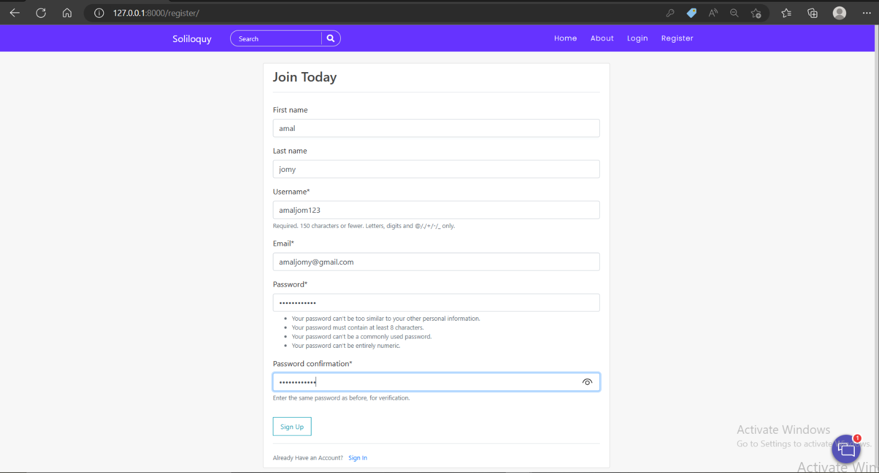
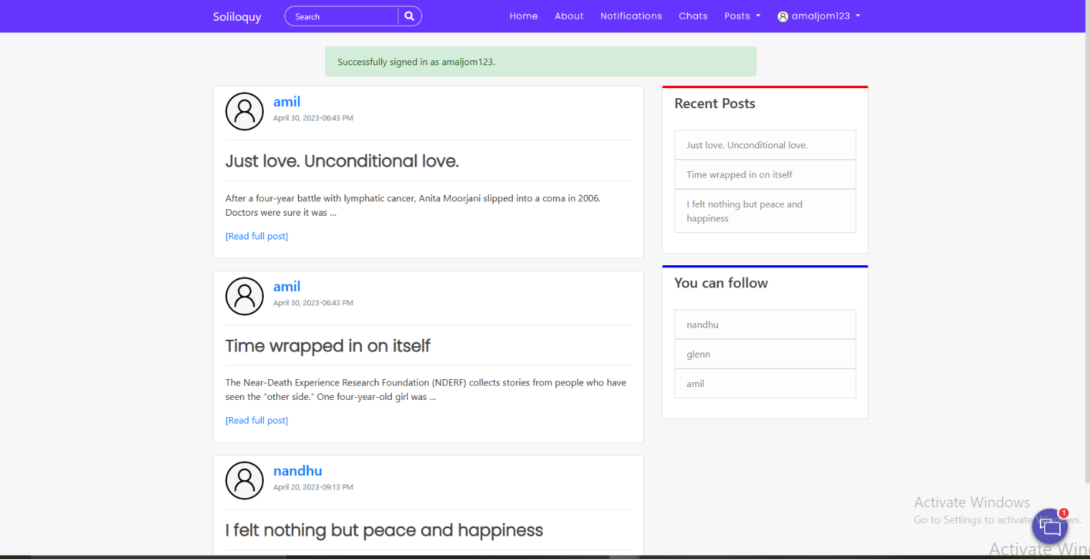
SOLILOQUY
Home
Requirements
Features
Technical
challenges
Future
REGISTRATION PAGE
FEED
users can view the post uploaded by other users
users can register their accounts through the registration page

Slide 9





SOLILOQUY
Home
Requirements
Features
Technical
challenges
TECHNICAL ASPECTS
Python
Jazzmin
PyCharm
Free and Open Source
Large standard Library
object- oriented scripting language
high-level programming language
Jazz up Admin Site
Responsive
Customisable UI
Python IDE
Tightly Integrated
Bootstrap
SQL database engine
high-reliability
free to use
Most popular HTML, CSS, and JavaScript framework.
Free to download and use
6

Slide 10
Libraries:
SOLILOQUY
Home
Requirements
Features
Technical
challenges
Future
channels:
It allows for the integration of WebSockets, HTTP/2, and other protocols to enable real-time messaging and notifications.
django-ckeditor:
It allows users to create rich-text content with formatting options and media embedding capabilities.
django-crispy-forms:
django-crispy-forms is a Django library that simplifies the rendering of HTML forms with Bootstrap styles.
django-jazzmin:
django-jazzmin is a Django library that provides a modern and responsive admin interface.
Pillow:
Pillow is a Python library for image processing and manipulation.

Slide 11
Architecture of the project
SOLILOQUY
Home
Requirements
Features
Technical
challenges
Future
Model:
The Model represents the data and the business logic of the application.
View:
The View is responsible for rendering the user interface and presenting the data to the users.
Templates:
Templates are responsible for generating dynamic HTML pages based on the data received from the views.
Static Files:
Static files such as CSS, JavaScript, and images are used to enhance the user interface and add interactivity.
Middleware:
Middleware components intercept and process requests and responses globally.
Third-Party Libraries and APIs:
Used third-party libraries and APIs to enhance its functionality and integrate additional features.
Some of them are django-jazzmin, Pillow, etc.

Slide 12
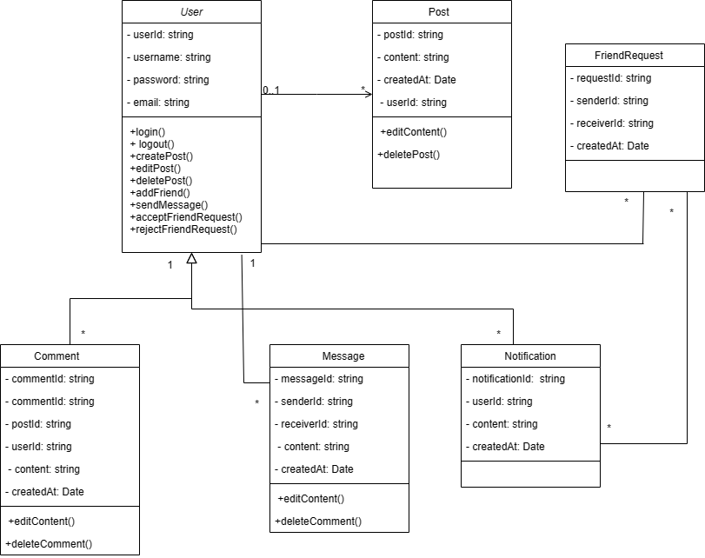
CLASS DIAGRAM

Slide 13
Challenges faced during the development
SOLILOQUY
Home
Requirements
Features
Technical
challenges
Future
Real-time Interactions and Notifications:
Implementing real-time features like messaging,
notifications, and updates can introduce
complexities.
Emotional Well-being Considerations:
Developing a platform for individuals
experiencing sadness and depression requires
sensitivity and empathy.
Implementation of AI- CHAT bot
Implementating AI- chat bot with the help of Kommunicate.io
User Privacy and Data Security:
Implementing robust security measures to
protect user data and ensure privacy can
be challenging.
Designing Intuitive User Interfaces:
Creating user-friendly interfaces that are
intuitive and accessible is a constant challenge.

Slide 14
FUTURE ENHANCEMENT
SOLILOQUY
Home
Requirements
Features
Technical
challenges
Future
Machine Learning-Based Sentiment Analysis:
Enhance the sentiment analysis feature by
incorporating machine learning algorithms.
Advanced Community Moderation Tools:
Implement advanced content moderation tools
to efficiently detect and handle inappropriate or
harmful content. Eg.Bad Word detector
Integration with Mental Health Professionals:
Collaborate with mental health professionals to
provide expert guidance and resources within
the platform.
Support Groups and Forums:
Create support groups or forums where users
can connect and engage in discussions on
specific topics related to sadness, depression,
and emotional well-being.
Personalized Recommendations:
Develop personalized recommendation systems
that suggest relevant content, resources, or
connections based on user preferences,
interests, and browsing history.
Mobile Application Development:
Build mobile applications for Soliloquy to offer a
more convenient and accessible user experience
on smartphones and tablets.

Slide 15
CONCLUSION
SOLILOQUY
Home
Requirements
Features
Technical
challenges
Future
In conclusion, Soliloquy presents a compelling solution for individuals experiencing sadness and depression by offering a safe and supportive social media platform. Through its features such as post sharing, interactive engagement, private messaging, and curated mental health resources, Soliloquy fosters a sense of community and provides a nurturing environment for users to express themselves, connect with like-minded individuals, and access valuable support. With its technical foundation built on Django, Bootstrap, PyCharm, Django-Jazzmin, SQLite, and Python, Soliloquy ensures an efficient and user-friendly experience. By addressing the emotional well-being of its users and promoting a sense of belonging, Soliloquy holds the potential to make a positive impact on the lives of those facing sadness and depression.

Slide 16
REFERENCES
SOLILOQUY
Home
Requirements
Features
Technical
challenges
Future
https://www.kommunicate.io/
https://testdriven.io/blog/django-channels/#:~:text=Django%20Channels%20%28or%20just%20Channels%29%20extends%20the%20built-in,MQTT%20%28IoT%29%2C%20chatbots%2C%20radios%2C%20and%20other%20real-time%20applications.
https://codewithstein.com/django-realtime-chat-app-tutorial-simple-django-tutorial-with-channels-and-redis/
(685) Build a Social Media App with Django – Python Web Framework Tutorial - YouTube
GIT HUB REPOSITORY LINK
https://github.com/nandhujayan/soliloquy.git

Slide 17
THANKS!
Nandhu Jayan
22pmc139

